Slide 1





HackOrbit 2025
K4-SpiritCourage

Slide 2

THEME & PROBLEM STATEMENT
Theme: Sustainable Environment & Green Technology
Excessive plastic use causes massive environmental pollution.
Plastic waste takes centuries to decompose, harming land, water,
and wildlife.
Lack of accessible platforms promoting plastic-free products.
Consumers need awareness about sustainable alternatives.

Slide 3

PROPOSED SOLUTION
To create a dedicated website ‘EcoTrust’ for plastic-free products.
Sell items made of eco-friendly materials (e.g. bamboo, metal, cloth).
Educate users about:
1. Benefits of non-plastic products
2. Drawbacks of plastic products
Encourage recycling by:
1. Collecting plastic waste from users
2. Offering discounts as incentives
3. Promote a sustainable lifestyle and conscious consumption.

Slide 4
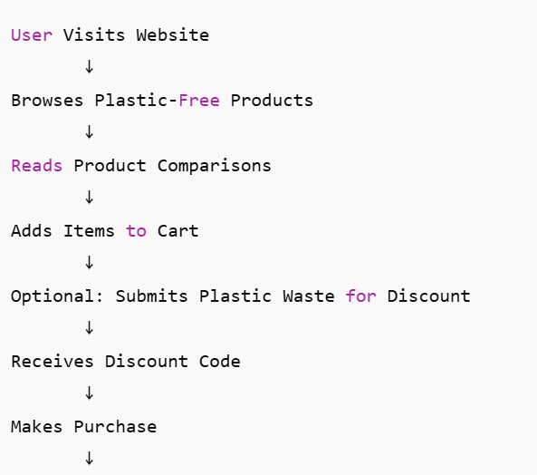
FLOWCHART

Slide 5

FLOWCHART (Explanation)
Users visit our website to explore eco-friendly alternatives.
Plastic waste submission feature gives customers discounts.
Website serves both as a shopping platform and an awareness hub.
Every purchase contributes to a cleaner environment.

Slide 6
FEATURES AND NOVELTY
Exclusive online store for plastic-free products.
Plastic vs non-plastic comparison section.
Plastic waste collection from customers in exchange for discounts.
User-friendly interface for sustainable shopping.
Promotes eco-awareness alongside commerce.

Slide 7

DRAWBACK AND SHOWSTOPPERS
Higher cost of non-plastic products may discourage some buyers.
Logistics challenges in collecting and handling plastic waste.
Limited suppliers for certain plastic-free products.
Need for strong marketing to build user trust and traffic.

Slide 8
Solutions for Drawbacks
To overcome the cost we can provide discount, and as we sell items from vendors they will be cheap.
We can collaborate with some of the companies that involve in plastic recycling.
Even though the suppliers can be limited. We can maintain good relations with them and provide best possible products to users.

Slide 9
K4-SpiritCourage
Name | Role | Contact
K. Hema Vardhan | Project Manager | hemavardhan5738@gmail.com
D. Rohith | Frontend Developer | rohithdoppalapudi614@gmail.com
Ch. Rupesh | Backend Developer | 2300031153cseh1@gmail.com
B. Charan | Content Writer | bcnrlg@gmail.com

Slide 10

Thank you

